Slide 1
A New Semantic Approach on Yelp Review-star Rating Classification
Shuang Wu, Xiaodong Wang, and Bozhao Qi
Notes:
Hello everyone.
I will discuss our project, the title is a new semantic approach on yelp review star rating classification
Here are my team mates, this is xiaodong, and this is shuang

Slide 2
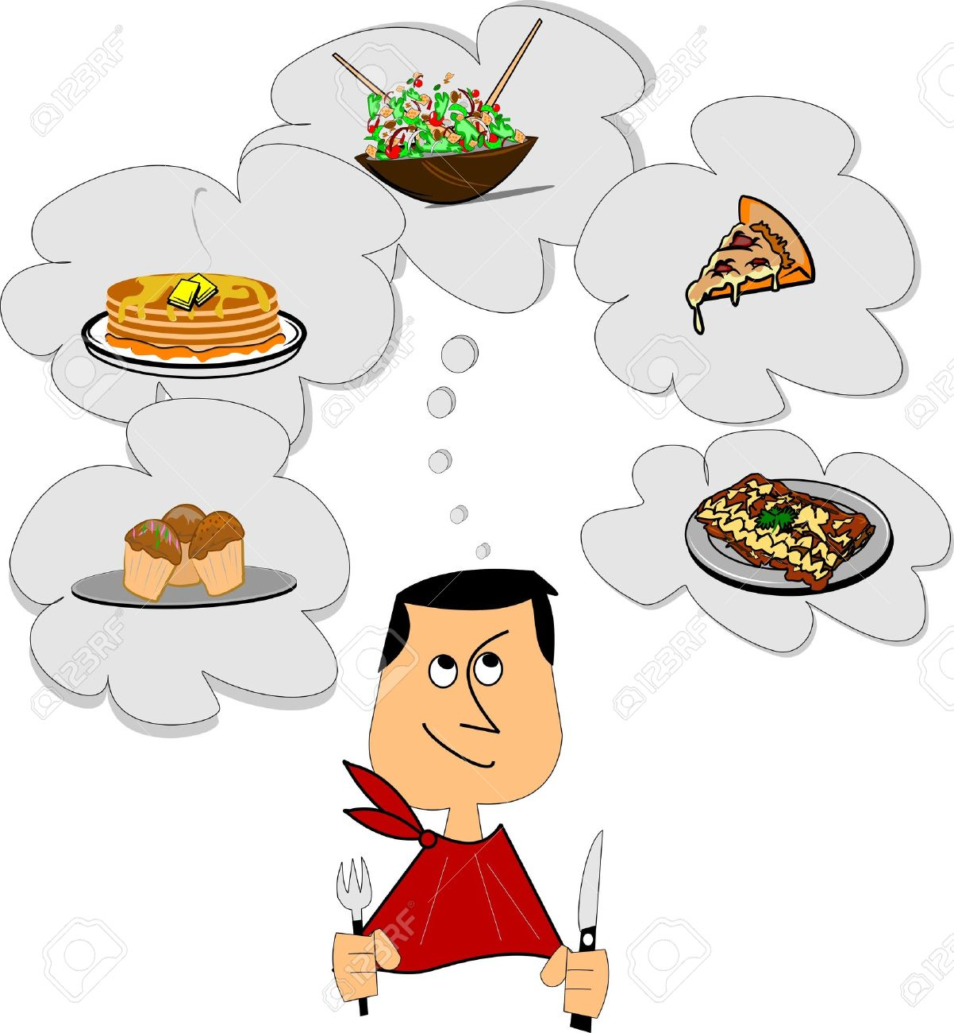
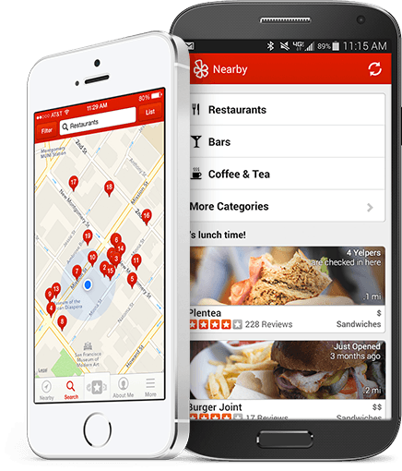

Introduction
Where should I eat?
Search for restaurants on Yelp
Find a 5-star restaurant on Yelp
Notes:
Our intuition is fairly simple.
Here is a situation happens almost to everyone
It is dinner time, but we are not sure where we should go, what we usually do is take out your phone, open yelp, trying to search a good restaurant nearby.
People usually find a restaurant with a higher star.
However, the review stars may not be a good feature to judge the restaurant. E.g. some good restaurants may not be visited by so many people, so it is hard for us to discover it.
Or even worse, the restaurant may create some fake data to fool you.

Slide 3

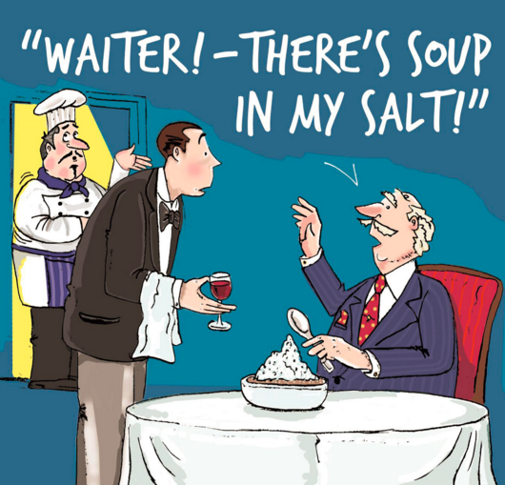

Introduction
Can we infer user review star from user text reviews?
Notes:
So we are wondering if there is another way to estimate the level
Our idea is to predict the review star based on the user review.
In the review text, customer will provide more detailed information about their experience.
Hence, this may be a good criteria to evaluate

Slide 4
Our Goal
Develop machine learning model to predict review stars based on review text
Extract useful feature vectors
Eliminate user personal preference
Easy going user
Picky user
Moderate user
Compare different machine learning algorithms
Explore large computing power

Slide 5
Dataset Overview
Original Table: obtain dataset from Yelp data challenge
Tips, Users, Reviews, Businesses table
2.2M reviews and 591K tips by 552K users for 77K businesses
566K business attributes, e.g., hours, parking availability, ambience.
Social network of 552K users for a total of 3.5M social edges.
Aggregated check-ins over time for each of the 77K businesses
200,000 pictures from the included businesses
Reference: https://www.yelp.com/dataset_challenge

Slide 6
Data Cleaning and Preprocessing
Use various Python and R packages to process data
Pandas DataFrame, Numpy, Matplotlib, wordcloud, etc
Process data from business, review, tip and user table
Rename the attributes in business, user, review and tip table
Duplicate attribute names appears in each table, e.g., “Name” in business and user respectively represent restaurant name and user name
“ name -> bussiness_name“ and “name - > user_name”
business_DF.rename(columns={'name': 'business_name', 'stars' : 'business_average_stars', 'review_count':'business_review_count'}, inplace=True)
Change data type for later computation
From object to int or float
user_DF['user_average_stars'] = user_DF['user_average_stars'].astype(float)

Slide 7
Data Cleaning and Preprocessing
Join above four tables into one to reduce table size
Join by {user_id, business_id, date}
Process user reviews
Some users give multiple review and tip for one business on the same day
Combine those reviews and tips and union text of tip and review into one attribute
review_DF2 = review_DF.groupby(['user_id','business_id', 'date'])['review_text'].apply(lambda x: ','.join(x)).reset_index()
Calculate an average review star for that review
review_DF1 = review_DF.groupby(['user_id','business_id', 'date'], as_index=False).mean()
Do inner join to get new review table
review_DF3 = pd.merge(review_DF1, review_DF2, on =['user_id', 'business_id', 'date'], how='inner')

Slide 8
Data Cleaning and Preprocessing
Apply same trick on tip table
Left join on review table and tip table
review_and_tip_DF = pd.merge(review_DF3, tip_DF1, on =['user_id', 'business_id', 'date'], how='left')
Combine review and tip into a new table:
review_and_tip_DF["text"] = review_and_tip_DF["review_text"].map(str) + ', ' + review_and_tip_DF["tip_text"].map(str)
Generate final table
Join all the table
business_user_review_and_tip_DF = pd.merge(user_review_and_tip_DF, business_DF, on =['business_id'], how='inner'

Slide 9
Data Cleaning and Preprocessing
Clean noise attributes
Drop attributes
business_user_review_and_tip_DF = business_user_review_and_tip_DF.drop(['attributes.Price Range','votes.cool', 'votes.funny', 'votes.useful'], 1)
Re-evaluate data
Yelp doesn’t provide all data
Need to recompute some value, e.g. average value, total count, etc.
temp_DF = business_user_review_and_tip_DF.groupby(['user_id']).mean()['review_stars'].reset_index()
temp_DF.rename(columns={'review_stars': 'user_average_stars'}, inplace=True)
business_user_review_and_tip_DF = pd.merge(business_user_review_and_tip_DF, temp_DF, on =['user_id'], how=’inner’)

Slide 10
Data Cleaning and Preprocessing
Drop old attributes in the table
Calculate new values based on the data we have, drop old ones
business_user_review_and_tip_DF = business_user_review_and_tip_DF.drop([‘businees_average_stars’], 1)
A quick demo of some preliminary results
Build a website to show results
Run on python flask server
localhost:5000

Slide 11
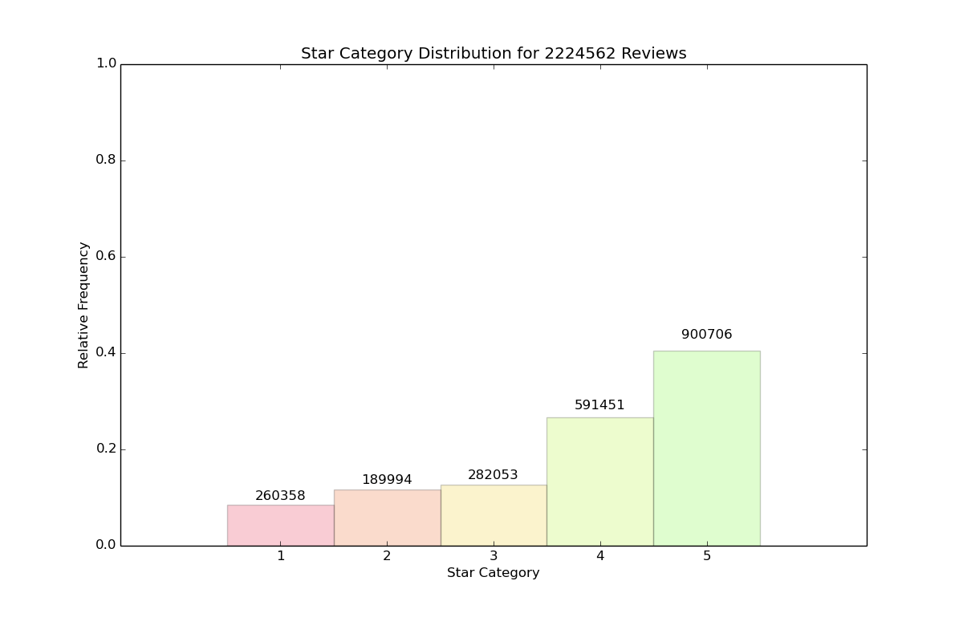
Exploratory Data Analysis
Star Category Distribution for 2224562 Reviews

Slide 12
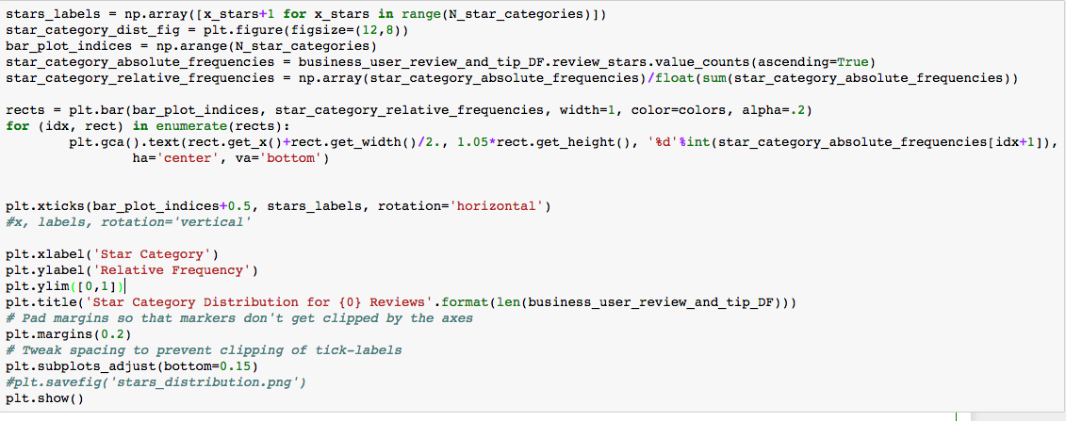
Exploratory Data Analysis - Code Snippet
Print out the overall star distribution using Matplotlib

Slide 13
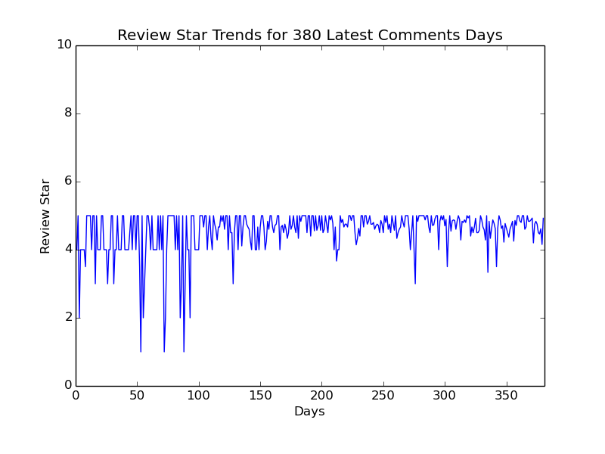
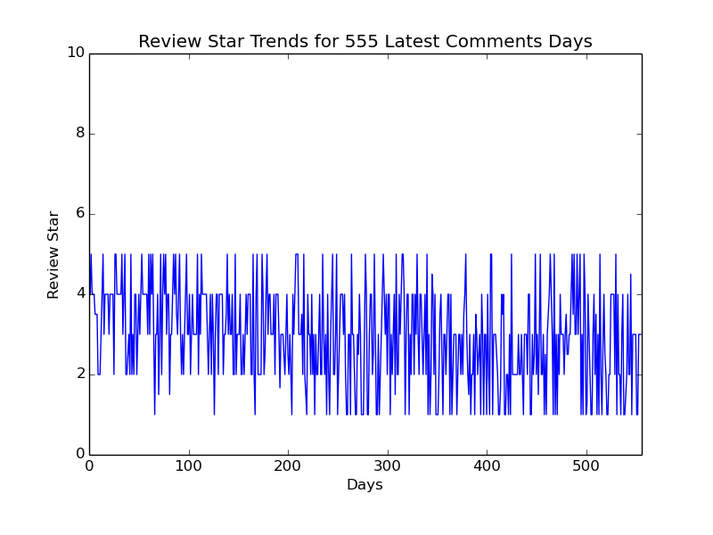
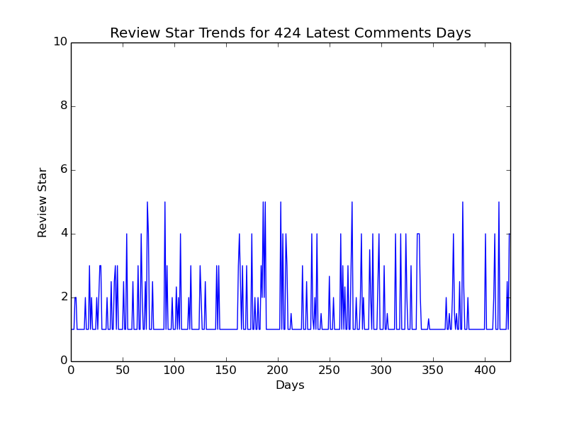
Exploratory Data Analysis
Good trend
Average trend
Bad trend

Slide 14
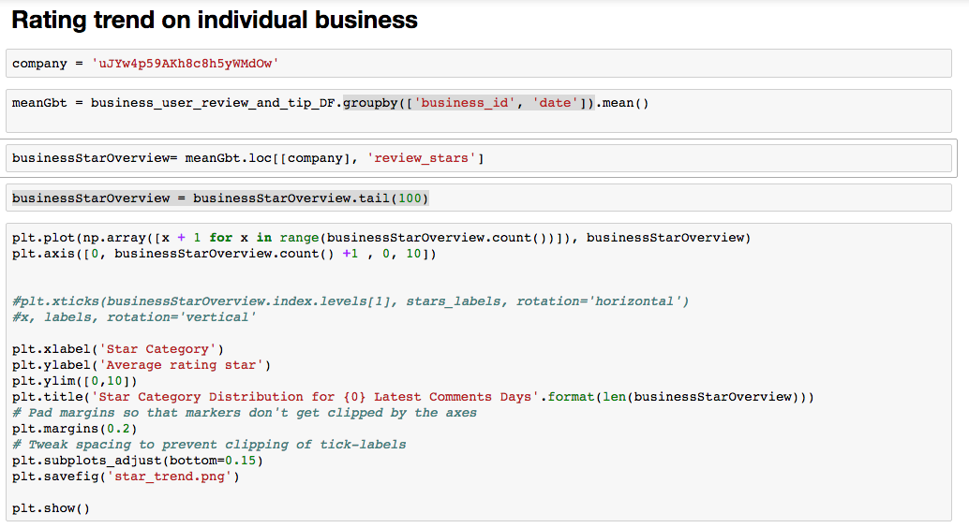
Exploratory Data Analysis - Code Snippet
Rating trend for each business

Slide 15
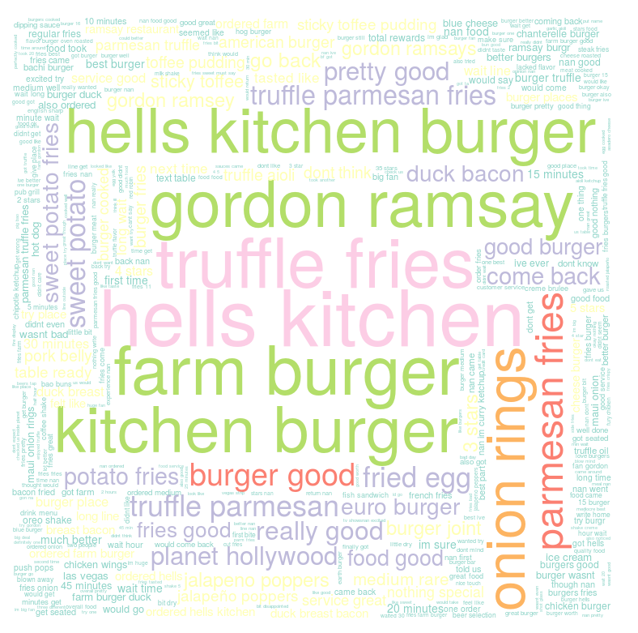
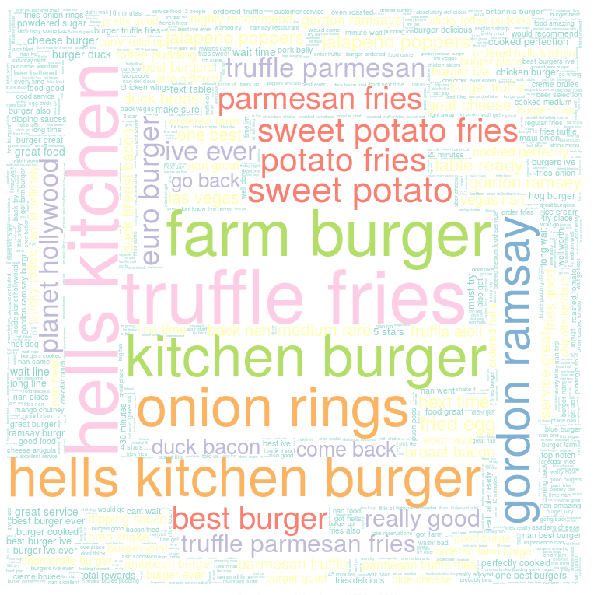
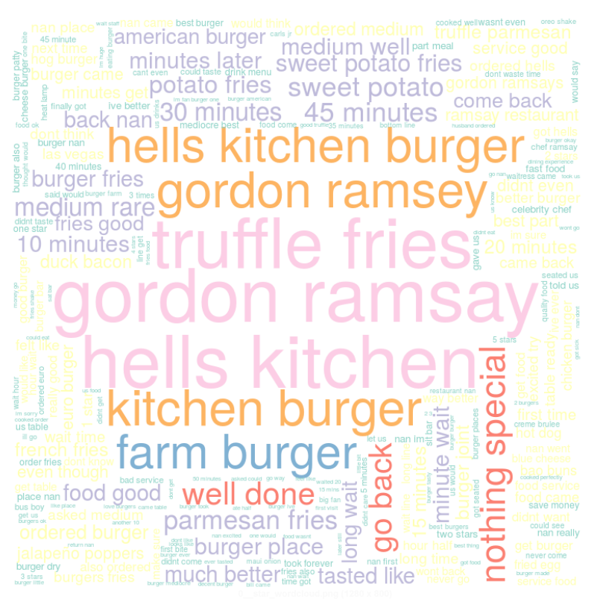
Exploratory Data Analysis
Good Review (4, 5 Stars)
Average Review (2,3 Stars)
Bad Review (1 Star)

Slide 16
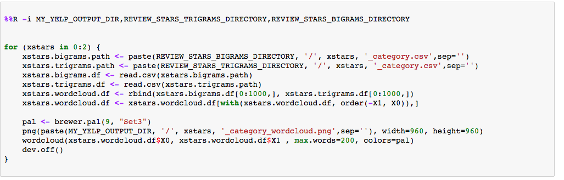
Exploratory Data Analysis - Code Snippet
Using R word cloud library
Group user reviews into three categories based on review stars

Slide 17
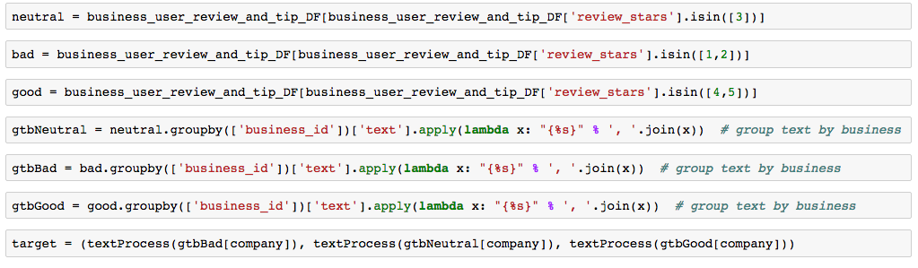
Exploratory Data Analysis - Code Snippet
Plot word cloud figure for each restaurant based on word frequency in each categories

Slide 18
Next…
Shuang will discuss machine learning and computing platform.

Slide 19
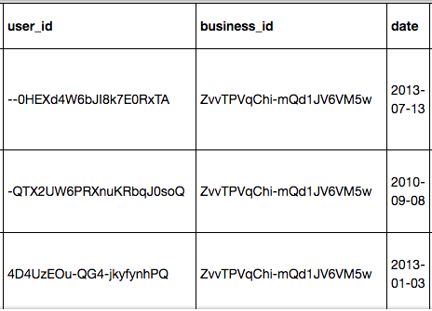
Machine learning
We use sklearn package for test on Ipython.
We are using only 2000 thousand tuples from the data wrangling

Slide 20
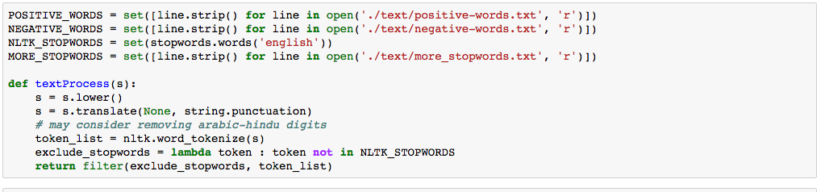
Using nltk package for tokenization and filtering
business_user_review_and_tip_DF['text'] = business_user_review_and_tip_DF['text'].apply(textProcess)

Slide 21
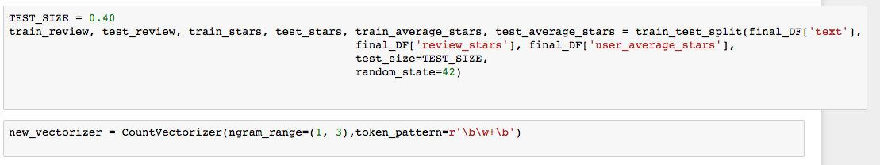
In the first round machine learning:
ngram_range=(1, 3) to vectorize our text , choosing the average user star, average business star as our feature vectors

Slide 22
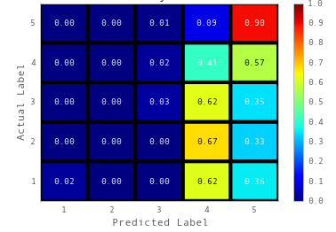

Train and Test on Multinominal Naive Bayes

Slide 23
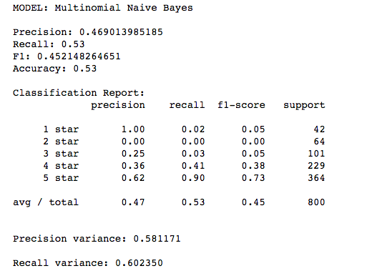
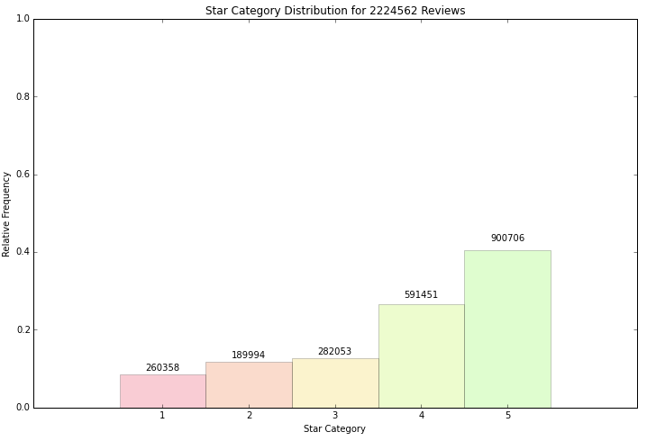
Multinominal Naive Bayes

Slide 24
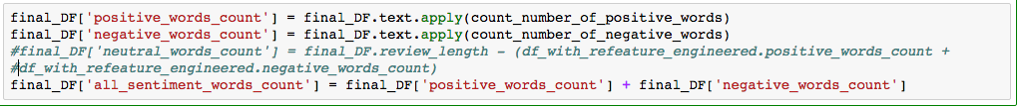
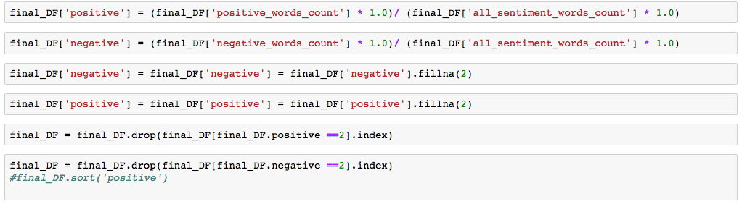
ReFeature to Improve Classifier Accuracy

Slide 25
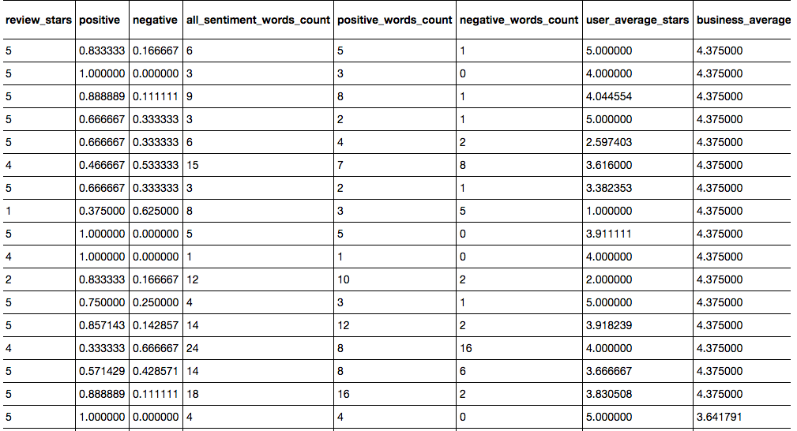

Slide 26
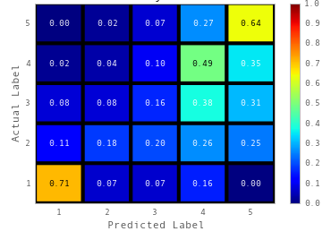
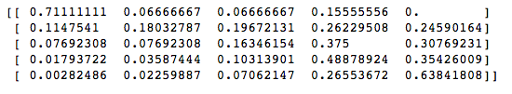
Better accuracy with better feature extraction

Slide 27
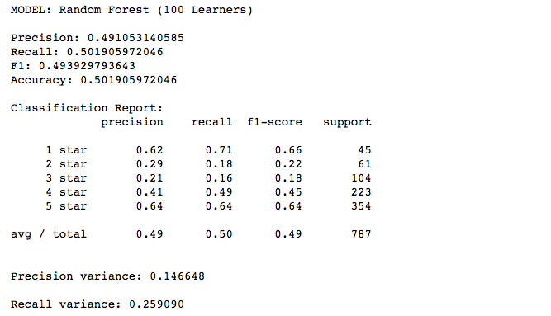
Decision tree result

Slide 28
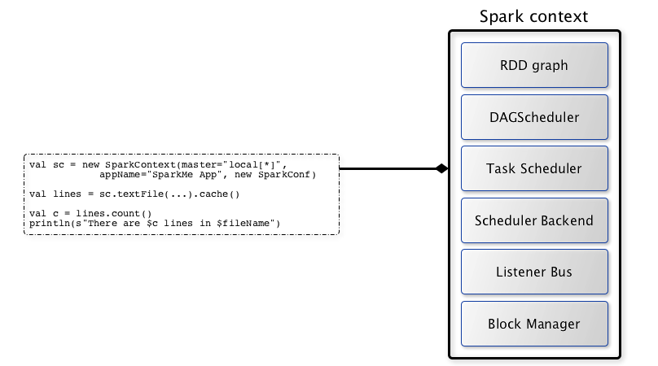
Spark
A Spark context is essentially a client of Spark’s execution environment and acts as the master of your Spark application

Slide 29
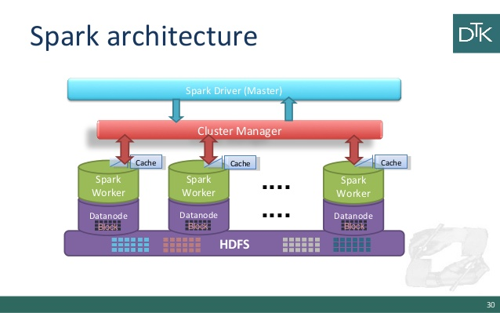
Better ? using the whole dataset

Slide 30
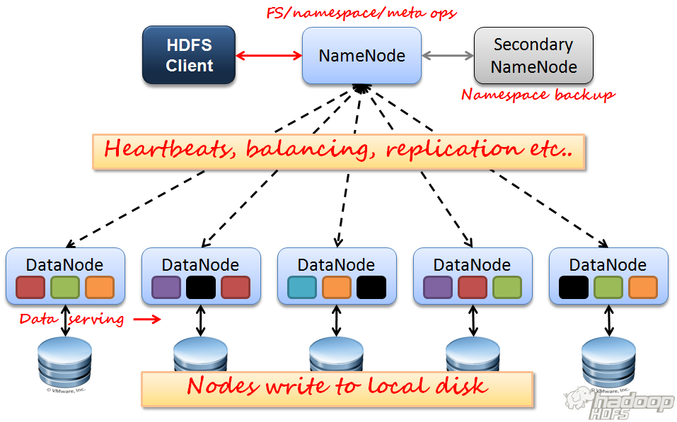

Slide 31
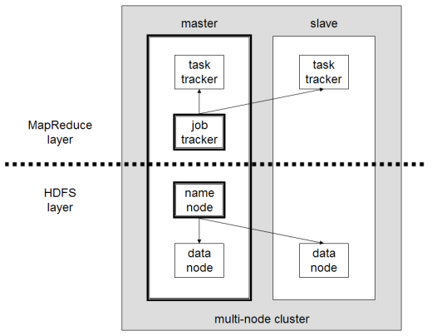

Slide 32
Next…
Xiaodong will discuss machine learning algorithms and analyse prediction results.

Slide 33
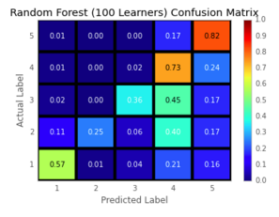
Predictive Analysis
Best result: (for 2M tuples)
Random forest precision: 0.68 recall: 0.70 recall RSS: 0.23 precision: 0.04

Slide 34
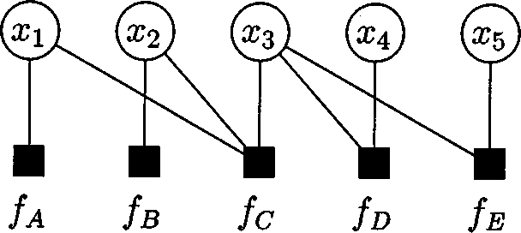
Belief Propagation Method
Probabilistic Inference: Computing a posteriori belief of a variable in a general Bayesian Network is NP-hard
Belief propagation method computes either exactly or approximately various marginal functions derived from the global function.
Factor Graph: deal with complicated global functions of many variables often exploit the manner in which the given functions factor as a product of “local” function, each of which depends on a subset of variables.
Let g( x1, x2, x3, x4, x5) be a function of five variables and suppose that g can be expressed as a product:
g( x1, x2, x3, x4, x5)
= fA(x1) fB(x2) fC(x1, x2, x3) fD(x3, x4) fE(x3, x5)

Slide 35
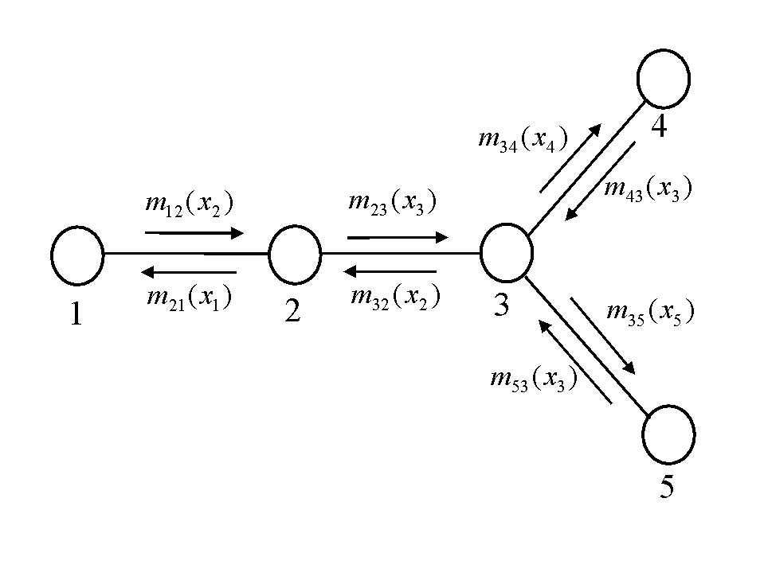

Standard Belief Propagation
In BP, introduce variables such as mij(xj), understood as a “message” from one node i to another node j about what state j should be
Message is a vector of the same dimensionality as xj, with each component being proportional to how likely node i thinks it is that node j will be in the corresponding state.
In the BP algorithm, the belief at a node i is proportional to the product of the local evidence at that node (φi(xi)) and all the messages coming into node i:
where k is a normalization constant and j is every node neighbouring i.

Slide 36

Standard Belief Propagation
The messages are determined self-consistently by the message update rules:
On the right hand side, take product over all messages going into the node i except for one coming from node j.
BP gives exact marginal probabilities for all the nodes in any singly-connected graph.
For this example, start with m43 and m53, then compute m32, then finally compute m21 and b1. This means that runtime has a direct ratio relation with number of links in the graph.

Slide 37
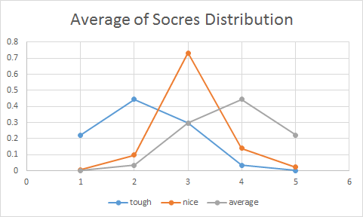
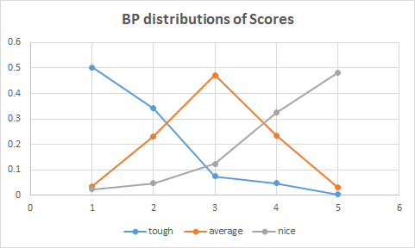
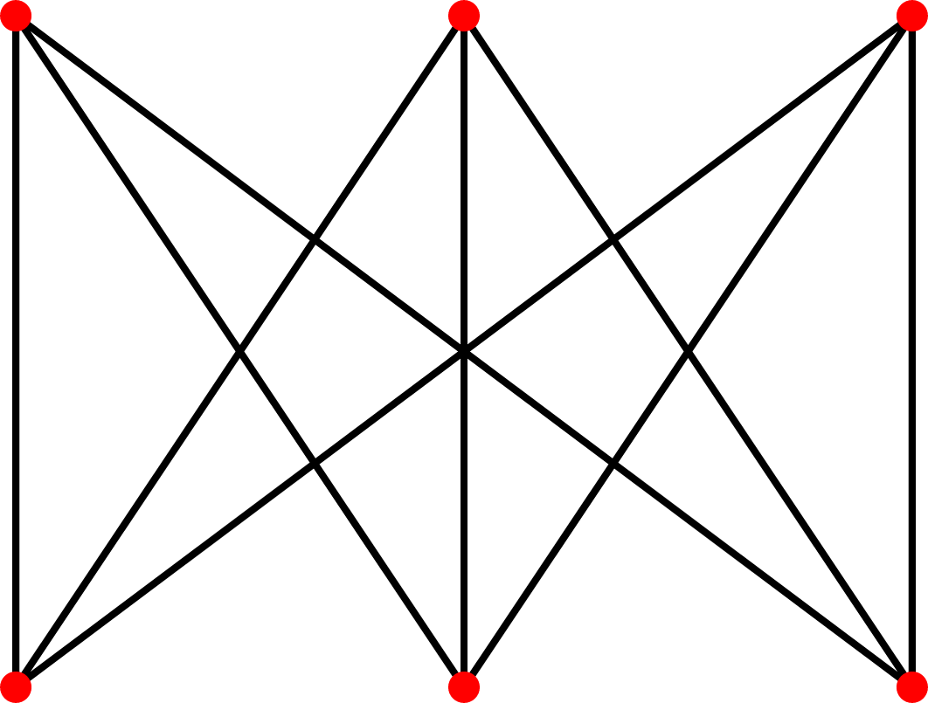
Test Case
Test model: a bipartite graph, 3 users and 3 restaurants
Each node on the top represents one kind of kind of users and each node at the bottom represents one kind of restaurants, 3 kinds of users: “rigid”, “average”, “nice”, all visited 3 kinds of restaurant: high level, average level and low level.
Each user node has a individual distribution for each kind of restaurant, 9 total distributions exist
Users
Rigid
Avg
Nice
High
Avg
Low
Distributions change from a normal distribution to an “exponential” distribution
Restaurants

Slide 38
Preprocessing Raw Data
Best Scenario: Each user treated as a node, for his/her “real” distribution, regardless of skewed distribution of restaurant he/she visited
Limitations: Computation Resource, frequent users visited more than 100 restaurants,unable to handle 5^100 elements within one matrix calculation
Alternative Solution: Use test model for simplification, limited to classified user/restaurant
Criteria: frequent user/restaurant for at least 30 appearance in the table
Threshold definition: Based on average stars classified as “nice” users, top 25% users, bottom 15% as tough users and 10% around the average review as average user, similar with restaurants, similar with restaurants
Data processing: join tables between 3 kinds of users and 3 kinds of restaurants, simply the model only limited to users within our interest visited restaurants within our interest

Slide 39
Preprocessing Raw Data
Model Setup: Test Model
Calculation Result: marginal distribution for each user
Feature Vector: Negative Word Counts, Positive Word Counts, All Sentiment Words Counts, Positive words percentage, Negative words percentage, Ratio between positive and negative, BP average stars, User average stars
Machine Learning methods: Random Forest, Naive Bayes (multinomial and Bernoulli), Support Vector Machines
After test, stick to Random Forest

Slide 40
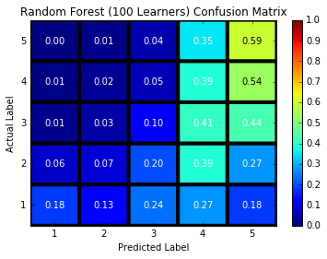
Result with no BP influence (Random Forest)
Feature Vectors:
Positive percentage, Negative percentage, Pos/Neg Ratio, Negative Word Counts, Positive Word Counts, All Sentiment Words Counts
Results:
Precision: 0.3600
Recall: 0.3878
Precision variance: 0.03484
Recall variance: 0.1918

Slide 41
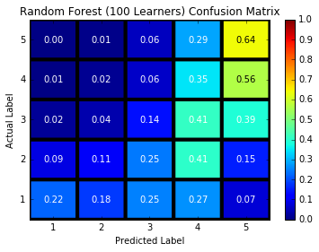
Result with no BP influence (Random Forest)
Fewer Feature Vectors:
Positive percentage, Negative percentage, Pos/Neg Ratio,
Results:
Precision: 0.3732
Recall: 0.3999
Precision variance: 0.0293
Recall variance: 0.1873

Slide 42
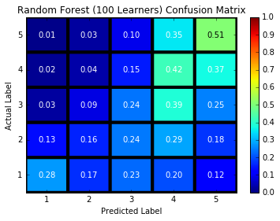
Result with no BP influence (Random Forest)
Feature Vectors:
Positive, Negative, User_average_stars, Pos/Neg Ratio,
Results:
Precision: 0.39532
Recall: 0.4012
Precision variance: 0.0572
Recall variance: 0.0809

Slide 43
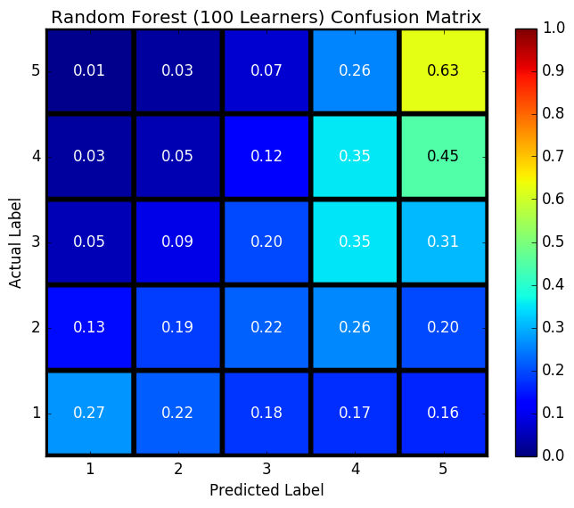
With BP Average Star
Feature Vectors:
Positive,Negative, Pos/Neg Ratio, BP_average_stars
Results:
Precision: 0.4271
Recall: 0.4495
Precision variance: 0.0686
Recall variance: 0.1840

Slide 44
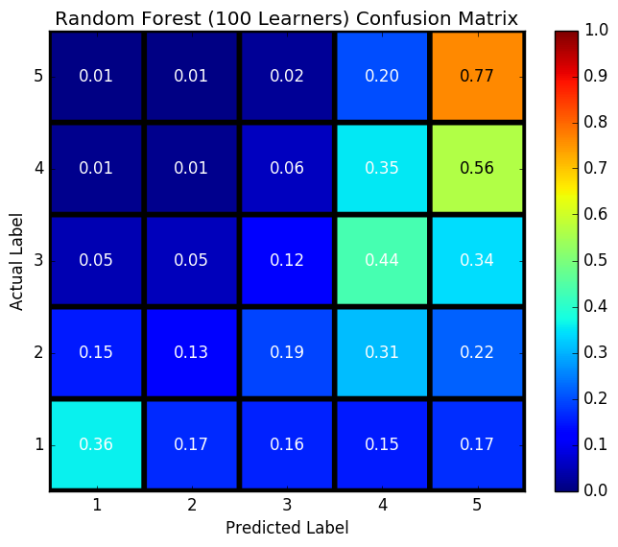
With BP Average Star
Feature Vectors:
Positive, Negative, Pos/Neg Ratio, user_average_stars, BP_average_stars,
Results:
Precision: 0.4891
Recall: 0.5145
Precision variance: 0.0499
Recall variance: 0.1308

Slide 45
Conclusion for BP:
Predicting exactly correct based on BP distribution and review is hard, future work involves BP distribution for each user.
If we limit our “star-suggestion” function only to three classes, precision and recall increase:
Precision improved to 74.4%
Recall improved to 82%
Precision and Recall improved compared with machine learning results without BP score
Feature Engineering involves more feature selection

Slide 46
Thank You!
Questions?

